Slide 1
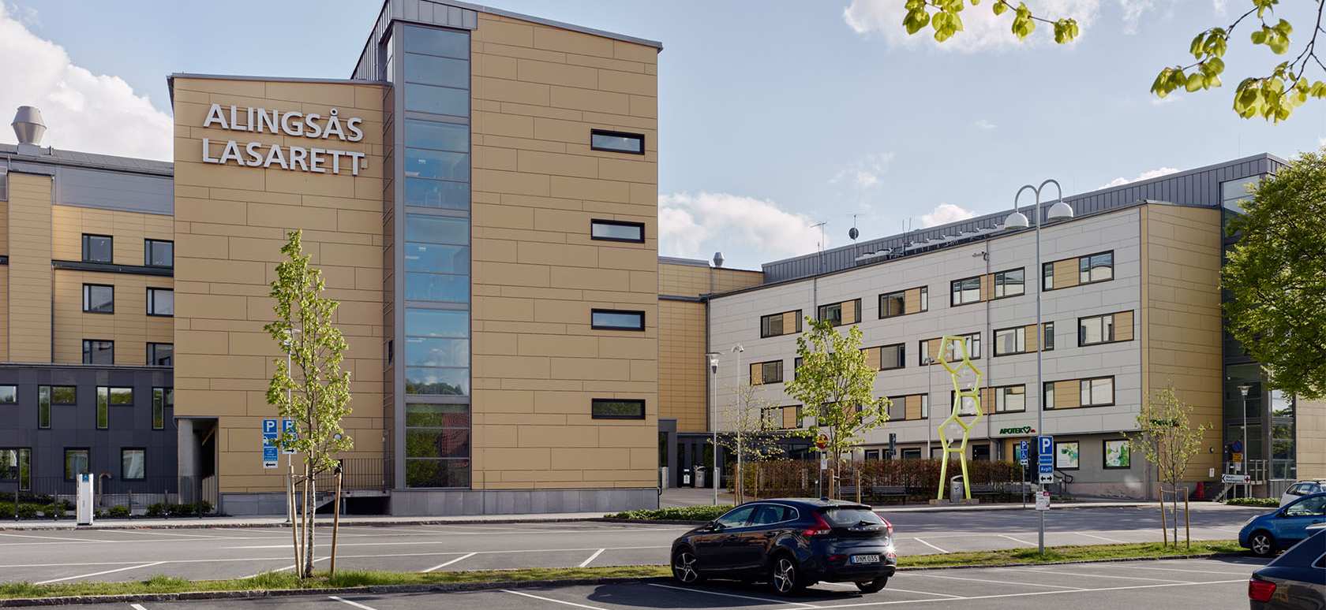
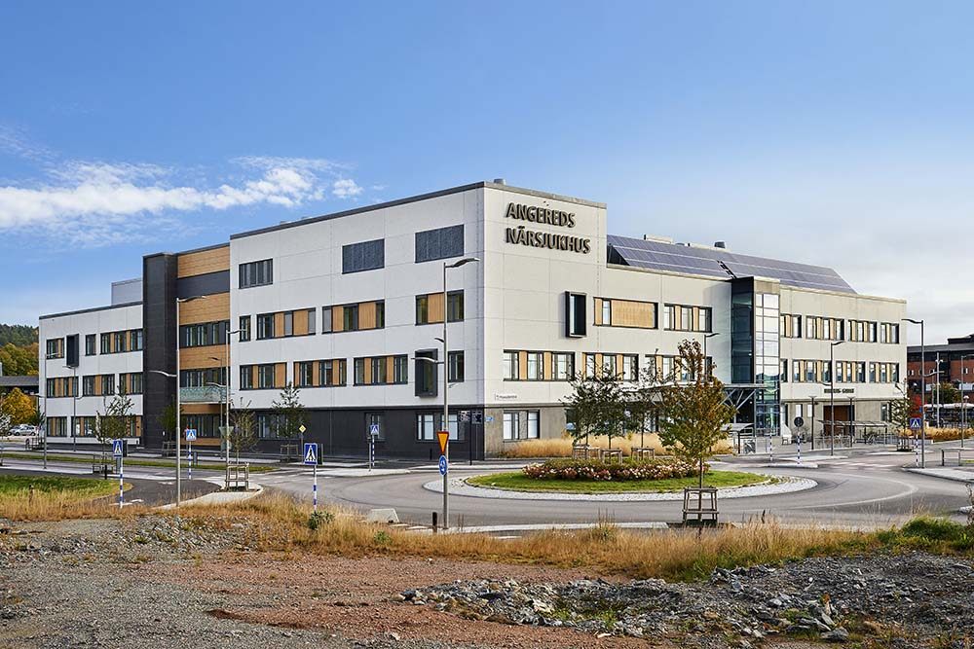
Bacterial contamination and greenhouse gas emissions – a randomized study of reuse versus single-use of infusion-set components for intravenous anaesthesia
Snorri Laxdal Karlsson, Jon Edman Wallér, Magni Vidar Gudmundsson, Peter Bentzer, Per Werner Moller

Slide 2
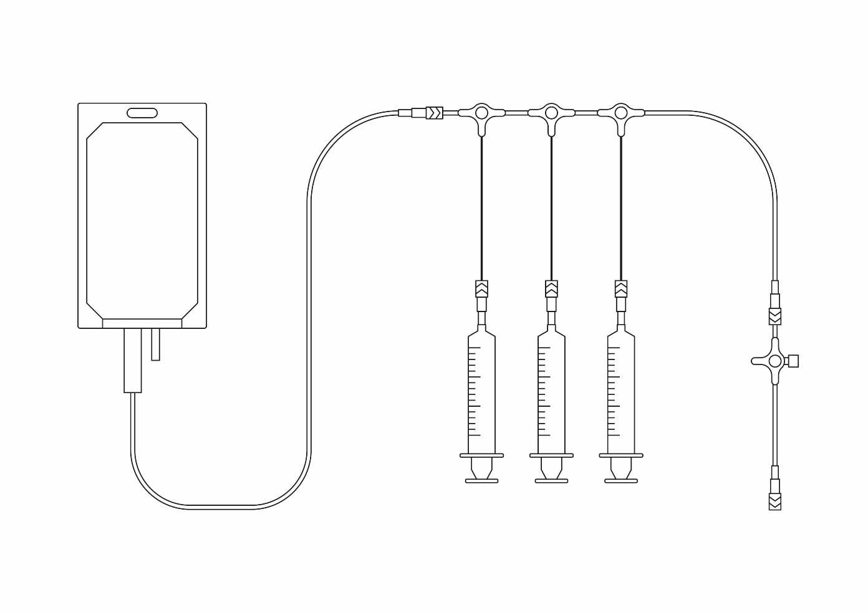
Bacterial contamination and greenhouse gas emissions - a randomised study of reuse versus single-use of infusion-set components for intravenous anaesthesia
348 procedures included after randomisation: reusing infusion-set components marked in green vs. single-use of all components
Reusing infusion-set components
Allowed three procedures per infusion set
Did not increase bacterial contamination
Reduced climate emissions by 69%
Reuse
Single-use
Karlsson et al. Eur J Anaesthesiol. September 2024
@EJA_Journal

Slide 3
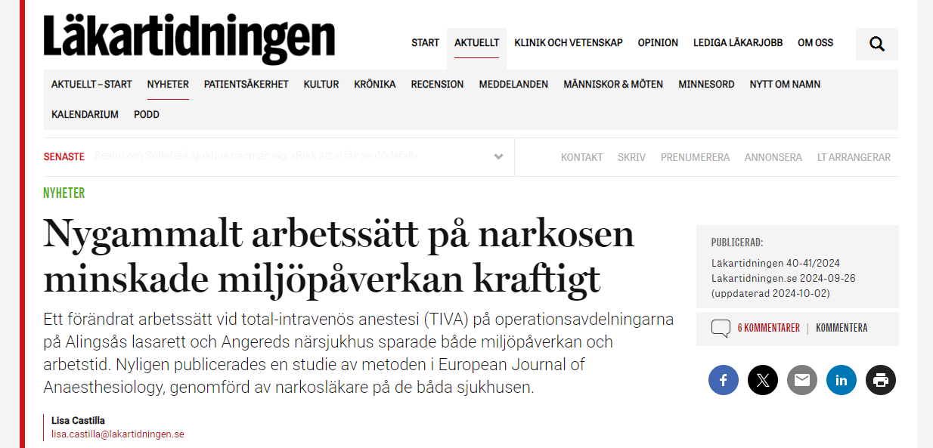

Slide 4
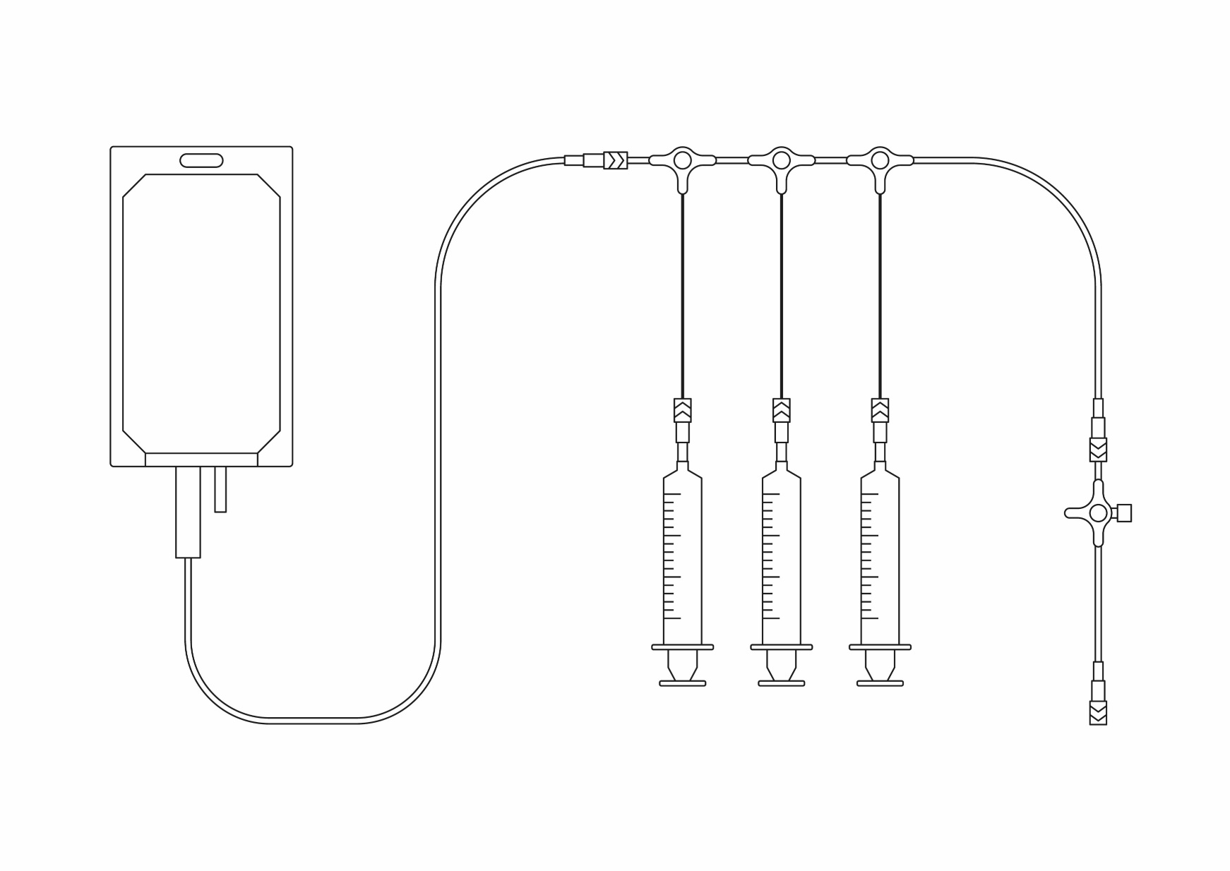
Built-in anti-reflux valve
Replaced between patients
Anti-reflux valves
10 cm infusion line with
three-way stopcock
Replaced when empty
Reused for several procedures
Sampling site

Slide 5
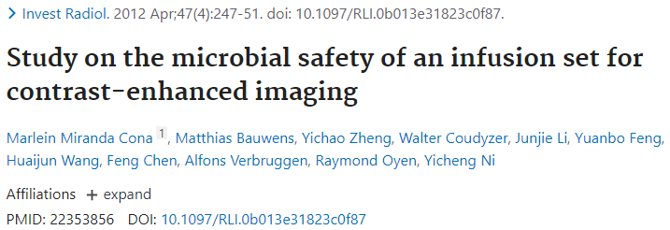
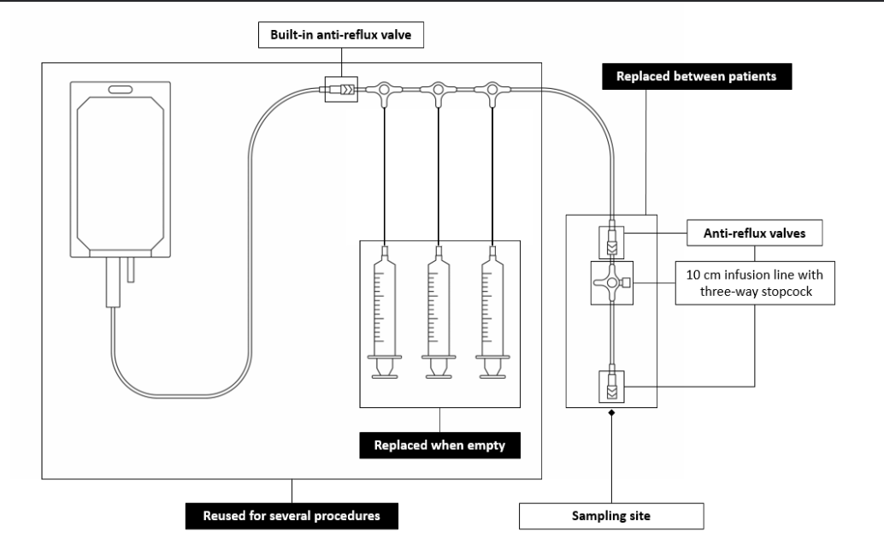
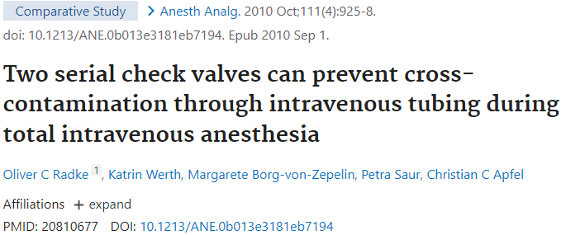

Slide 7
HSLF-FS 2021:32
EU 2017/745 (MDR)

Slide 8
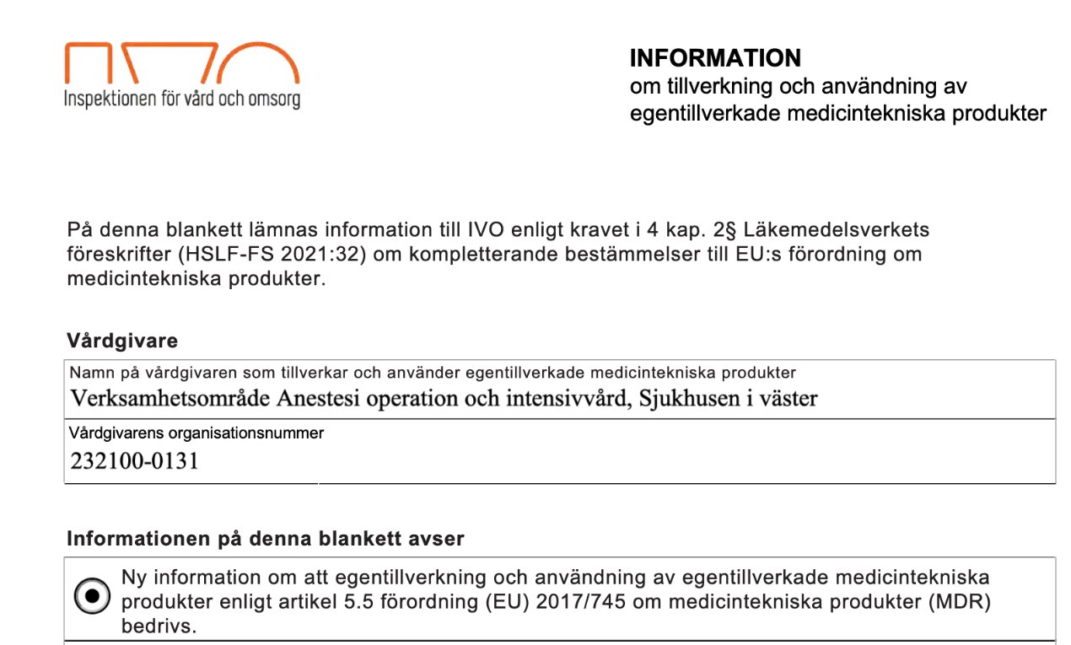
HSLF-FS 2021:32

Slide 9
Prevalens av bakteriell kontaminering för varje metod
Jämföra klimatpåverkan mellan metoderna

Slide 10
Prevalens av bakteriell kontamination okänd på avdelningen?
Tidigare studier: 6-33%
Acceptabel prevalens? Klinisk signifikans?
150 procedurer per metod
>10%
<10%

Slide 11
Inklusion och randomisering:
operationssalar där >1 operation planerades
Registrerade:
metod
duration
antal interaktioner med infusionssetet
tillförd mängd läkemedel
kvarvarande mängd läkemedel
turordning

Slide 12
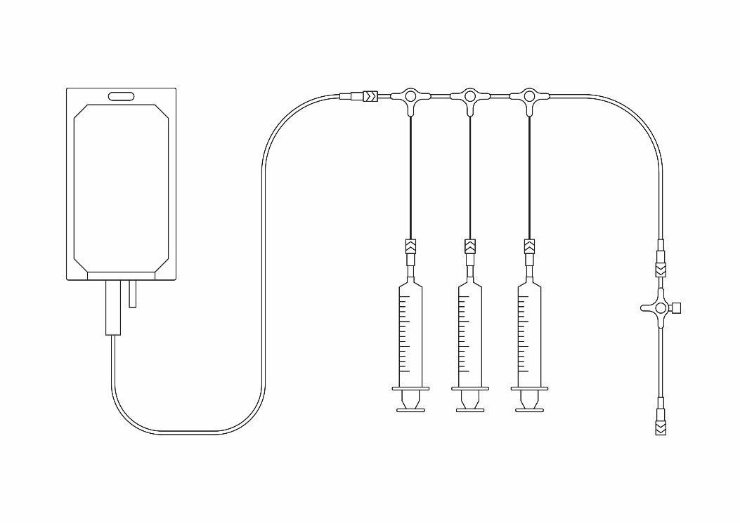
Injektioner i trevägskranen
Opslut:
Infusionsslangen kopplas från pvk
Infusionsvätskan flyttas till aerob odlingsflaska.

Slide 13
Operating rooms eligible for inclusion*
(n=108)
Operating rooms randomised to manage procedures by reuse
(n=54)
Operating rooms randomised to manage procedures by single use
(n=54)
Randomisation
Procedures allocated to reuse (n=194)
Did not receive allocated intervention (n=1):
Blood pressure measured in TIVA infusion arm
Received allocated intervention (n=193)
Procedures allocated to single use (n=165)
Did not receive allocated intervention (n=2):
Incorrect assembling of infusion set
Received allocated intervention (n=163)
Allocation
Lost to follow up (n=2):
Two samples injected into the same culture bottle
Lost to follow up (n=2):
Forgot to take sample
No time to secure sample due to clinically challenging emergence from anaesthesia
Follow up
Excluded from analysis (n=2):
Protocol violated by administering antibiotics via TIVA infusion set
Analysed (n=189)
Excluded from analysis (n=2):
Protocol violated by administering antibiotics via TIVA infusion set
Analysed (n=159)
Analysis

Slide 14
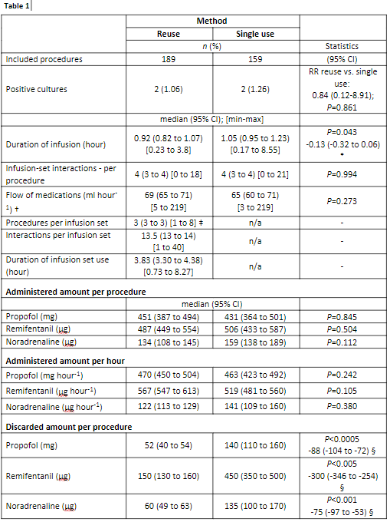
4/348 - 1,15% kontaminering
Micrococcus – metod A, 3/3
Staph epidermidis – metod A 3/5
Staphylococcus – metod B
Staph epidermidis – metod B
vid flergångsanvändning kasserades mindre läkemedel
Propofol - minskning med 63%
Noradrenalin – minskning med 56%
Ingen skillnad mellan metoderna
3 procedurer per infusions-set
Studien hade styrka (power) att upptäcka absolut risk-skillnad på 6,4%
13 interventioner per infusions-set
Remifentanil – minskning med 67%

Slide 15
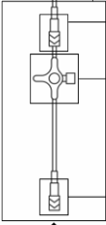
6 min 49 sek
44 sek

Slide 16
Prevalens av bakteriell kontaminering för varje metod
Jämföra klimatpåverkan mellan metoderna

Slide 17
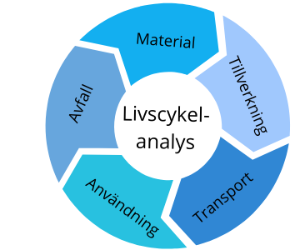

Slide 18
Greenhouse gas emissions
∆ -0.96 (-0.99 to -0.93)
P<0.0005
Σ 1.39 (1.37-1.40)
0.077
0.447
0.130
0.070
0.013
Σ 0.43 (0.41-0.47)
0.129
0.029
0.634
0.023
0.061
0.185
0.013
Reuse (n = 189)
Single use (n = 159)

Slide 19
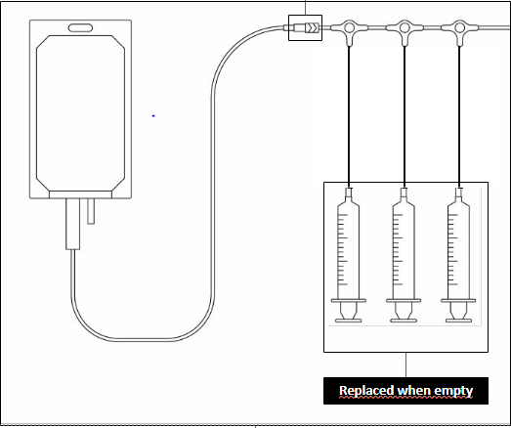
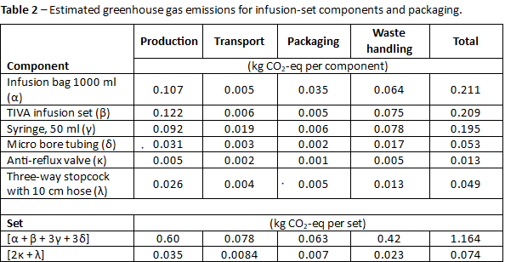
1,16 kg CO₂-eq
0,07 kg CO₂-eq

Slide 20
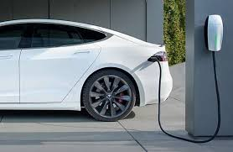
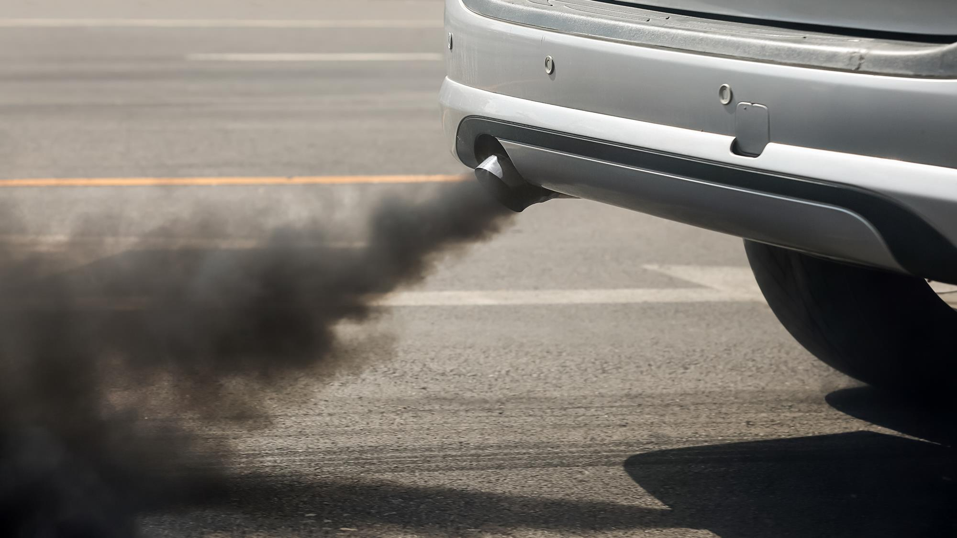
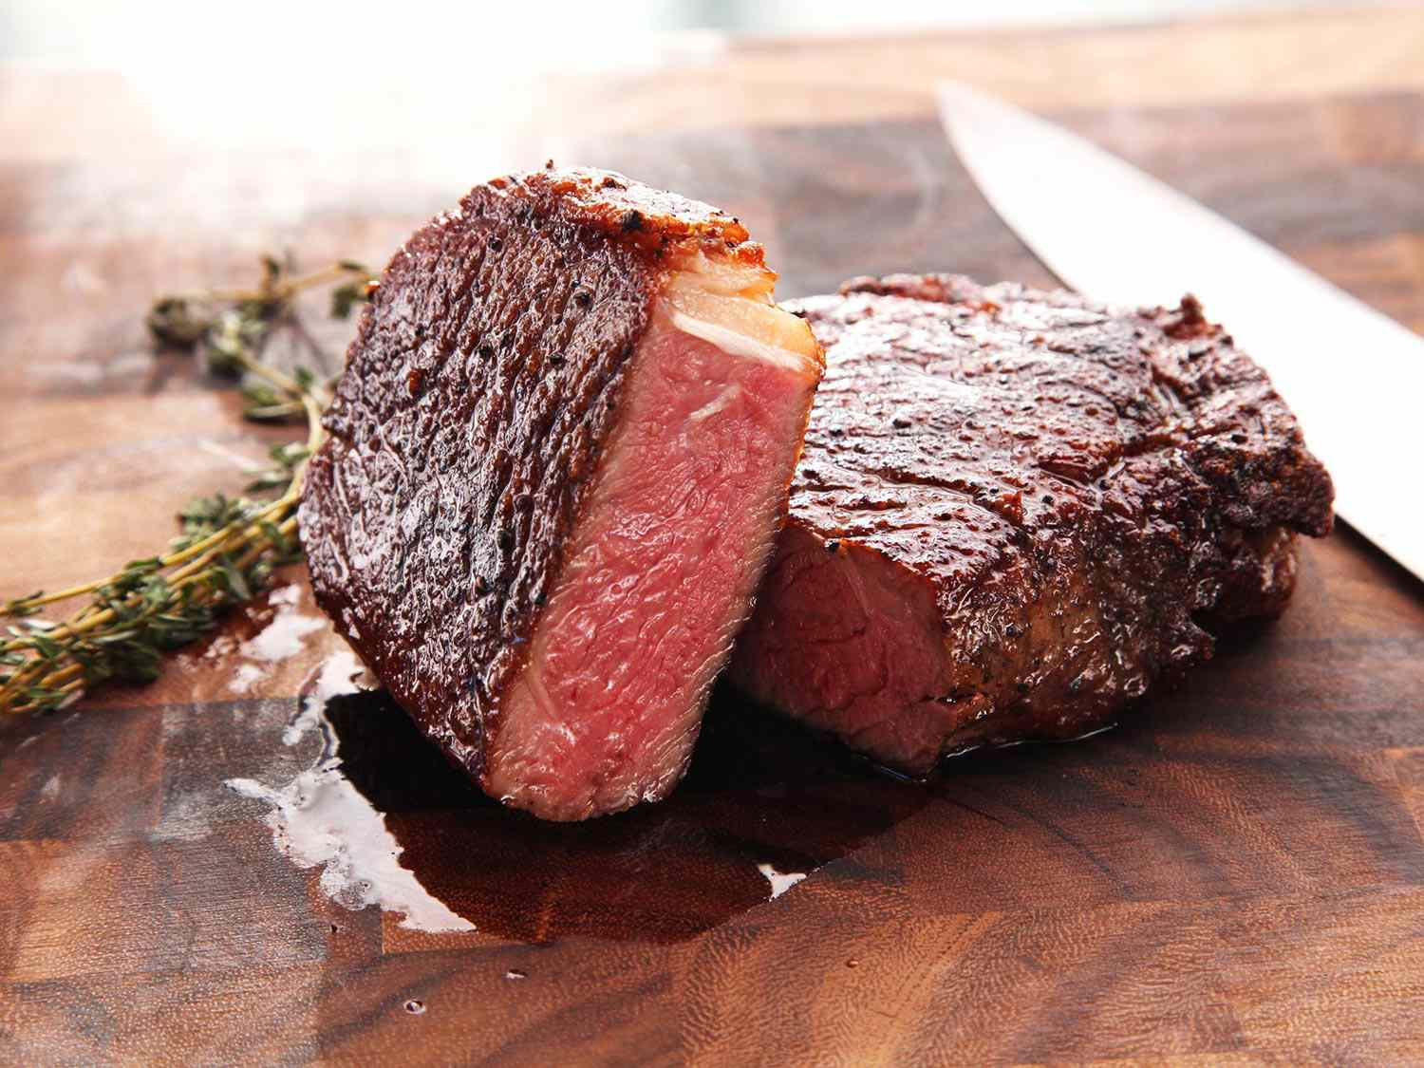
Greenhouse gas emissions
∆ -0.96 (-0.99 to -0.93)
P<0.0005
Σ 1.39 (1.37-1.40)
0.077
0.447
0.130
0.070
0.013
Σ 0.43 (0.41-0.47)
0.129
0.029
0.634
0.023
0.061
0.185
0.013
Reuse (n = 189)
Single use (n = 159)

Slide 21
Låg prevalens av bakteriell kontamination i båda metoder
mkt större studie behövs för att hitta skillnad mellan metoderna
Återanvändning av infusions-set minskar klimatavtrycket

Slide 22
per.moller@vgregion.se
snorri.laxdal.karlsson@vgregion.se

